Slide 1
Bioenergetics and Metabolism
Naglaa Fathy Alhusseini
Ass. Prof of Biochemistry
nagla.alhusseini@fmed.bu.edu.eg

Slide 2
Metabolism
All intracellular biochemical reactions used the simplest units of nutrients (glucose- Fatty acids- glycerol and amino acids) for either building up (anabolism) or breakdown (catabolism)

Slide 3
Anabolism
Building up (Synthesis) of complex molecules
Endergonic = consumes energy
e.g. Biosynthesis of glycogen, triacylglycerols and proteins

Slide 4
Catabolism
Breakdown (Degradation) of complex molecules
Exergonic = releases energy
e.g. Oxidation of glucose, Oxidation of fatty acids, etc.

Slide 5
Energy
It is the capacity to do work or the ability to make a change
The energy in our body have two types
1- heat energy body temp.
2- Free energy trapped or collected as high ℗ bond
ATP

Slide 6
Formation of ATP
1- Substrate Level Phosphorylation
S~P + ADP S + ATP
Kinase

Slide 7
Oxidative Phosphorylation (Respiratory chain level )
SH2 +NAD S + NADH⁺ + H⁺
Respiratory chain
ATP
H2O

Slide 8
Respiratory chain
Oxidation process accompanied with liberation of energy ΔG, that stored as high energy phosphate bond ~ P (ATP) for further uses
The process includes:
1- Oxidation: gradual transfer of hydrogen and electron (Low Redox potential ) to oxygen (high Redox potential) .
Redox potential : the ability to accept an electron ē
The electron transfers from components with low Redox potential to components with high Redox potential.

Slide 9
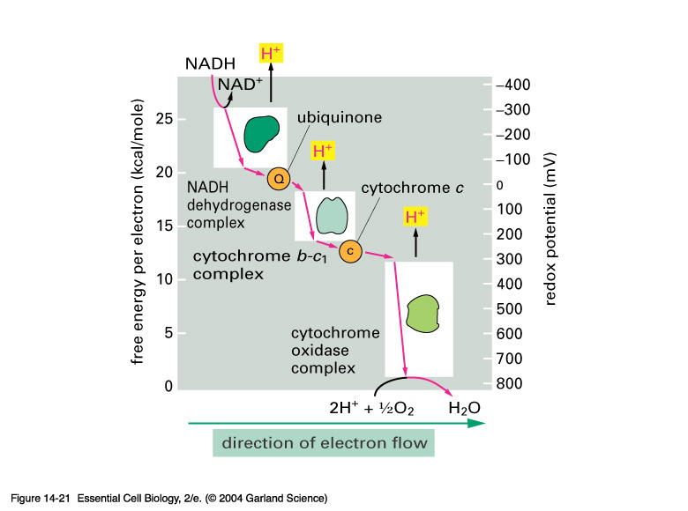
↑ reducing properties
Redox potential „E“
Gibbs energy „G“
↑ oxidizing properties

Slide 10
Phosphorylation :
The energy liberated from oxidation stored in the form of high energy phosphate bonds ~ P (ATP)
ADP + pi + ΔG ATP
ATP synthetase

Slide 11
Respiratory chain
It is a group of oxidation reduction reaction through them the hydrogen is gradually transfer to oxygen to form water and liberate energy ΔG which stored as high ~ ℗ (ATP)
Oxidative – phosphorylation process
Site: Inner mitochonderial membrane enzymes

Slide 13
Sequence of events
1- Oxidation reduction processes between NAD, FAD and coQ occur by transfer of hydrogen
2- Oxidation reduction processes inn cytochromes occur by transfer of electron
3- When respiratory chain starts by NADH+H⁺ , 3 ℗ incorporated to 3 ADP form 3ATP when ½ O2 (O) incorporated with H2 to form H2O
4- When respiratory chain starts by FADH2 , 2 ℗ incorporated to 2 ADP form 2ATP when ½ O2 (O) incorporated with H2 to form H2O

Slide 14
P/O ratio:
It is the ratio between inorganic phosphates consumed to form ATP in relation to oxygen atom reduced forming water in the respiratory chain.
1-In case of oxidation of NADH+H⁺ it is 3/1 (3 ATPs formed at 3 coupling sites),
2-in case of oxidation of FADH₂ it is 2/1 (2 ATPs formed at 2 coupling sites).

Slide 15
: Uncouplers of Oxidative Phosphorylation
Uncouplers are substances that inhibit the oxidative phosphorylation by ETC. They dissociate oxidation from phosphorylation.
Uncouplers allow electron transport to proceed without ATP synthesis.
Uncouplers allow leakage or transport of H+ across the membrane, thus collapsing the proton gradient for ATP synthesis
The oxidation of hydrogen with oxygen to form H₂O proceeds while no phosphorylation of ADP to ATP.
The free energy liberated during oxidation is lost as heat, so uncouplers cause the body temperature to rise (cause hotness).

Slide 16
Examples of uncouplers of Oxidative phosphorylation
2,4-Dinitrophenol (DNP) and Pentachlorophenol:
Warfarin: is a rat poison
Barbiturates
Dicumarol
Bilirubin: in abnormal high levels as in jaundice
Calcium: in large dose
Thyroid hormones (T3 & T4): in abnormal high levels as in hyperthyroidism
Toxins: of some bacteria and fungus

Slide 17
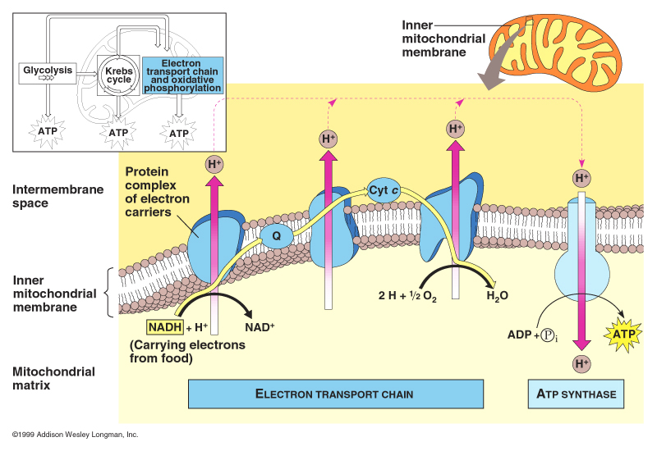

Slide 18
↑ reducing properties
Redox potential „E“
Gibbs energy „G“
↑ oxidizing properties
9/29/2015
Nagla Alhusseini
18

